Slide 1

What You Need to Know to Get the Most Out of Your American Rescue Plan Act Funds
Presented by
Jack Reagan
State and Local Government Practice Leader

Slide 2
Agenda
Project qualifications
Financial reporting requirements
Application assistance
Support for finding future funding streams

Slide 3
Project Qualifications

Slide 4
What can ARPA funds be used for?
Respond to or mitigate the COVID-19 health emergency or its negative economic impacts, including:
  assistance to households
  small businesses
  nonprofits
  aid for tourism, travel, and hospitality
To provide essential workers with premium pay
Cover revenue loss incurred as a result of the COVID-19 emergency
Address systemic public health and economic challenges that have contributed to the unequal impact of the pandemic
To make necessary investments in water, sewer, or broadband infrastructure

Slide 5
Public health projects
1: Public Health | EC
COVID-19 Mitigation & Prevention
COVID-19 Vaccination | 1.10
COVID-19 Testing | 1.20
COVID-19 Contact Tracing | 1.30
Prevention in Congregate Settings (Nursing Homes, Prisons/Jails, Dense Work Sites, Schools, Child care facilities, etc.) | 1.40
Personal Protective Equipment | 1.50
Medical Expenses (including Alternative Care Facilities) | 1.60
Other COVID-19 Public Health Expenses (including Communications, Enforcement, Isolation/Quarantine) | 1.70
COVID-19 Assistance to Small Businesses | 1.80
COVID 19 Assistance to Non-Profits | 1.90
COVID-19 Aid to Impacted Industries | 1.10
Community Violence Interventions
Community Violence Interventions*^ | 1.11
Behavioral Health
Mental Health Services*^ | 1.12
Substance Use Services*^ | 1.13
Other
Other Public Health Services^ | 1.14
^Denotes areas where recipients must report on whether projects are primarily serving disadvantaged communities (see Project Demographic Distribution slides for details)
*Denotes areas where recipients must identify the amount of the total funds that are allocated to evidence-based interventions (see Use of Evidence slides for details)

Slide 6
Negative economic impact projects
2: Negative Economic Impacts | EC
Assistance to Households
Household Assistance: Food Programs*^ | 2.1
Household Assistance: Rent, Mortgage, and Utility Aid*^ | 2.2
Household Assistance: Cash Transfers*^ | 2.3
Household Assistance: Internet Access Programs*^ | 2.4
Household Assistance: Paid Sick and Medical Leave^ | 2.5
Household Assistance: Health Insurance*^ | 2.6
Household Assistance: Services for Un/Unbanked*^ | 2.7
Household Assistance: Survivor's Benefits^ | 2.8
Unemployment Benefits or Cash Assistance to Unemployed Workers*^ | 2.9
Assistance to Unemployed or Underemployed Workers (e.g. job training, subsidized employment, employment supports or incentives)*^ | 2.1
Healthy Childhood Environments: Child Care*^ | 2.11
Healthy Childhood Environments: Home Visiting*^ | 2.12
Healthy Childhood Environments: Services to Foster Youth or Families Involved in Child Welfare System*^ | 2.13
Healthy Childhood Environments: Early Learning*^ | 2.14
Long-term Housing Security: Affordable Housing*^ | 2.15
Long-term Housing Security: Services for Unhoused Persons*^ | 2.16
Housing Support: Housing Vouchers and Relocation Assistance for Disproportionately Impacted Communities*^ | 2.17
Housing Support: Other Housing Assistance*^ | 2.18
Social Determinants of Health: Community Health Workers or Benefits Navigators*^ | 2.19
^Denotes areas where recipients must report on whether projects are primarily serving disadvantaged communities (see Project Demographic Distribution slides for details)
*Denotes areas where recipients must identify the amount of the total funds that are allocated to evidence-based interventions (see Use of Evidence slides for details)

Slide 7
Negative economic impact projects (continued)
2: Negative Economic Impacts | EC
Assistance to Households
Social Determinants of Health: Lead Remediation*^ | 2.2
Medical Facilities for Disproportionately Impacted Communities^ | 2.21
Strong Healthy Communities: Neighborhood Features that Promote Health and Safety^ | 2.22
Strong Healthy Communities: Demolition and Rehabilitation of Properties^ | 2.23
Addressing Educational Disparities: Aid to High-Poverty Districts^ | 2.24
Addressing Educational Disparities: Academic, Social, and Emotional Services*^ | 2.25
Addressing Educational Disparities: Mental Health Services*^ | 2.26
Addressing Impacts of Lost Instructional Time^ | 2.27
Contributions to UI Trust Funds^ | 2.28
Assistance to Small Businesses
Loans or Grants to Mitigate Financial Hardship^ | 2.29
Technical Assistance, Counseling, or Business Planning*^ | 2.3
Rehabilitation of Commercial Properties or Other Improvements^ | 2.31
Business Incubators and Start-Up or Expansion Assistance*^ | 2.32
Enhanced Support to Microbusinesses*^ | 2.33
Assistance to Non-Profits
Assistance to Impacted Nonprofit Organizations (Impacted or Disproportionately Impacted)^ | 2.34
Aid to Impacted Industries
Aid to Tourism, Travel, or Hospitality^ | 2.35
Aid to Other Impacted Industries^ | 2.36
Other
Economic Impact Assistance: Other*^ | 2.37
^Denotes areas where recipients must report on whether projects are primarily serving disadvantaged communities (see Project Demographic Distribution slides for details)
*Denotes areas where recipients must identify the amount of the total funds that are allocated to evidence-based interventions (see Use of Evidence slides for details)

Slide 8
Premium Pay
4: Premium Pay | EC
Public Sector Employees | 4.1
Private Sector: Grants to Other Employers | 4.2

Slide 9
Infrastructure projects
5: Infrastructure | EC
Water and Sewer
Clean Water: Centralized Wastewater Treatment | 5.1
Clean Water: Centralized Wastewater Collection and Conveyance | 5.2
Clean Water: Decentralized Wastewater | 5.3
Clean Water: Combined Sewer Overflows | 5.4
Clean Water: Other Sewer Infrastructure | 5.5
Clean Water: Stormwater | 5.6
Clean Water: Energy Conservation | 5.7
Clean Water: Water Conservation | 5.8
Clean Water: Nonpoint Source | 5.9
Drinking water: Treatment | 5.1
Drinking water: Transmission & Distribution | 5.11
Drinking water: Lead Remediation, including in Schools and Daycares | 5.12
Drinking water: Source | 5.13
Drinking water: Storage | 5.14
Drinking water: Other water infrastructure | 5.15
Water and Sewer: Private Wells | 5.16
Water and Sewer: IIJA Bureau of Reclamation Match | 5.17
Water and Sewer: Other | 5.18
Broadband
Broadband: “Last Mile” projects | 5.19
Broadband: IIJA Match | 5.2
Broadband: Other projects | 5.21

Slide 10
Key words for public health project abstracts
Mitigate impact of COVID-19
Community disproportionately impacted
Community in a Qualified Census Tract
Disproportionate public health or economic outcomes on a specific population, households or geographic area
Exacerbation of health disparities due to pandemic
Pre-existing social vulnerabilities exacerbated as result of pandemic

Slide 11
Key words for negative economic impact project abstracts
Mitigate impact of pandemic-related recession on households
Program aimed at low-wage workers to assist in recovery
Reduce food insecurity
Reduce housing insecurity
Reduce risk of longer-term effects on earnings and economic potential

Slide 12
Key words to demonstrate promoting equitable outcomes
12
Describe how project will serve historically underserved, marginalized or adversely affected groups within the community
Describe how you are equitably serving the residents and businesses within the community

Slide 13
Key words to demonstrate promoting equitable outcomes
13
Address how you are ensuring that the administrative requirements of the project don’t result in disparities in ability to complete applications or meet project eligibility criteria
Describe how intended outcomes are focused on
  Closing gaps
  Reaching universal levels of service
  Disaggregating progress by race, ethnicity or other equity dimensions

Slide 14
Projects serving disadvantaged communities
14
See “^” on slides 4 through 9 for ARPA project categories that require disadvantaged communities consideration
Certain projects must report how those projects are targeted to economically disadvantaged communities
Defined by HUD’s Qualified Census Tract
May assume funds count towards such communities if:
  A program or service is provided at a physical location in a Qualified Census Tract
  A program or service where the primary intended beneficiaries live within a Qualified Census Tract;
  A program or service for which the eligibility criteria are such that the primary intended beneficiaries earn less than 60 percent of the median income for the relevant jurisdiction; or
  A program or service for which the eligibility criteria are such that over 25 percent of intended beneficiaries are below the federal poverty line.

Slide 15
Projects serving disadvantaged communities
15
May use reasonable estimates to determine if a project meets one of these criteria, including identifying the intended beneficiaries of a program or service in terms of
  income characteristics,
  geographic location, or
  otherwise estimating the beneficiaries of a program based on its eligibility criteria.
Do not need to track information on each individual beneficiary to make the determination of whether or not the project is serving an economically disadvantaged community.

Slide 16
Mandatory data to be gathered for certain projects
16
Household Assistance (EC 2.2) and Housing Support (EC 2.16-2.18):
  Number of people or households receiving eviction prevention services (including legal representation)
  Number of affordable housing units preserved or developed
Negative Economic Impacts (EC 2):
  Number of workers enrolled in sectoral job training program
  Number of workers completing sectoral job training programs
  Number of people participating in summer youth employment programs

Slide 17
Mandatory data to be gathered for certain projects
17
Education Assistance (EC 2.24-2.26):
  Number of students participating in evidence-based tutoring programs
Healthy Childhood Environments (EC 2.11-2.14):
  Number of children served by childcare and early learning (pre-school/pre-K/ages 3-5)
  Number of families served by home visiting

Slide 18
Mandatory data to be gathered for certain projects
18
Education Assistance (EC 2.24-2.26):
  Number of students participating in evidence-based tutoring programs
Healthy Childhood Environments (EC 2.11-2.14):
  Number of children served by childcare and early learning (pre-school/pre-K/ages 3-5)
  Number of families served by home visiting

Slide 19
Mandatory data to be gathered for certain projects
19
Education Assistance (EC 2.24-2.26):
  Number of students participating in evidence-based tutoring programs
Healthy Childhood Environments (EC 2.11-2.14):
  Number of children served by childcare and early learning (pre-school/pre-K/ages 3-5)
  Number of families served by home visiting

Slide 20
Mandatory data to be gathered for certain projects
20
Education Assistance (EC 2.24-2.26):
  Number of students participating in evidence-based tutoring programs
Healthy Childhood Environments (EC 2.11-2.14):
  Number of children served by childcare and early learning (pre-school/pre-K/ages 3-5)
  Number of families served by home visiting

Slide 21
Financial Reporting Requirements
21

Slide 22
Project level tracking
Expenditures: Once a project is approved, the recipient must be able to report on the project’s obligations and expenditures, including:
current period obligation
cumulative obligation
current period expenditure
cumulative expenditure
Project Status: Once a project is entered, the recipient will be asked to report on project status each reporting period, in four categories:
not started
completed less than 50 percent
completed 50 percent or more
completed

Slide 23
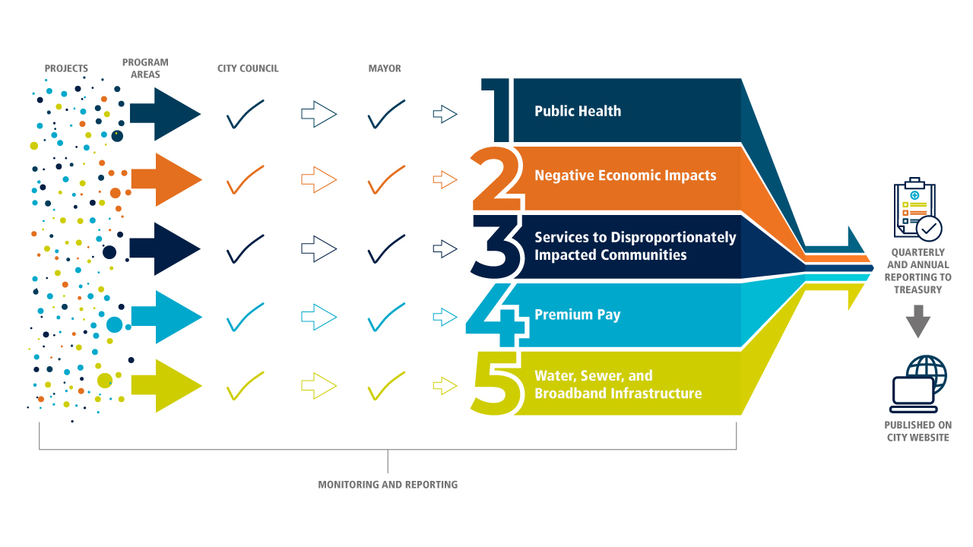
Reporting
23

Slide 24
Quarterly reports
Report # | Year | Quarter | Period Covered | Due Date
1 | 2021 | 2 and 3 | Award Date – September 30 | 10/31/2021
2 | 2021 | 4 | October 1 to December 31 | 1/31/2022
3 | 2022 | 1 | January 1 to March 31 | 4/30/2022
4 | 2022 | 2 | April 1 to June 30 | 7/31/2022
5 | 2022 | 3 | July 1 to September 30 | 10/31/2022
6 | 2022 | 4 | October 1 to December 31 | 1/31/2023
7 | 2023 | 1 | January 1 to March 31 | 4/30/2023
8 | 2023 | 2 | April 1 to June 30 | 7/31/2023
9 | 2023 | 3 | July 1 to September 30 | 10/31/2023
10 | 2023 | 4 | October 1 to December 31 | 1/31/2024
11 | 2024 | 1 | January 1 to March 31 | 4/30/2024
12 | 2024 | 2 | April 1 to June 30 | 7/31/2024
13 | 2024 | 3 | July 1 to September 30 | 10/31/2024
14 | 2024 | 4 | October 1 to December 31 | 1/31/2025
15 | 2025 | 1 | January 1 to March 31 | 4/30/2025
16 | 2025 | 2 | April 1 to June 30 | 7/31/2025
17 | 2025 | 3 | July 1 to September 30 | 10/31/2025
18 | 2025 | 4 | October 1 to December 31 | 1/31/2026
19 | 2026 | 1 | January 1 to March 31 | 4/30/2026

Slide 25
Application Assistance
25

Slide 26
Application Overview
26

Slide 27
Application Overview
27

Slide 28
Application Overview
28

Slide 29
Application Overview
29

Slide 30
Application Overview
30

Slide 31
Application Overview
31

Slide 32
Application Overview
32

Slide 33
Application Overview
33

Slide 34
Application Overview
34

Slide 35
Application Overview
35

Slide 36
Support for finding future funding streams
36

Slide 37
Want more information?
Jack Reagan
State and Local Government Practice Leader
410 423 4832| jreagan@uhy-us.com
Stacy Farber
Principal
860 221 7609| sfarber@uhy-us.com

Slide 38
Copyright © 2021 UHY LLP. All rights reserved.
Our firm provides the information in this webinar as tax information and general business or economic information or analysis for educational purposes, and none of the information contained herein is intended to serve as a solicitation of any service or product. This information does not constitute the provision of legal advice, tax advice, accounting services, investment advice, or professional consulting of any kind. The information provided herein should not be used as a substitute for consultation with professional tax, accounting, legal, or other competent advisors. Before making any decision or taking any action, you should consult a professional advisor who has been provided with all pertinent facts relevant to your particular situation. Information presented in this webinar is not intended to be used, and cannot be used by any taxpayer, for the purpose of avoiding accuracy-related penalties that may be imposed on the taxpayer. The information is provided "as is," with no assurance or guarantee of completeness, accuracy, or timeliness of the information, and without warranty of any kind, express or implied, including but not limited to warranties of performance, merchantability, and fitness for a particular purpose.
UHY Advisors, Inc. provides tax and business consulting services through wholly owned subsidiary entities that operate under the name of "UHY Advisors." UHY Advisors, Inc. and its subsidiary entities are not licensed CPA firms. UHY LLP is a licensed independent CPA firm that performs attest services in an alternative practice structure with UHY Advisors, Inc. and its subsidiary entities. UHY Advisors, Inc. and UHY LLP are U.S. members of Urbach Hacker Young International Limited, a UK company, and form part of the international UHY network of legally independent accounting and consulting firms. "UHY" is the brand name for the UHY international network. Any services described herein are provided by UHY Advisors and/or UHY LLP (as the case may be) and not by UHY or any other member firm of UHY. Neither UHY nor any member of UHY has any liability for services provided by other members.

